Slide 1


Slide 2

GRADUATION THESIS
CONSTRUCTING LANE DEPARTURE WARNING SYSTEM WITH RASPBERRY PI
Advisor: Nguyen Dang Quang, M.S
Student:
Nguyen Tuan Kiet 14110348
Nguyen Quoc Tinh 14110422

Slide 3


Introduction
Theoretical background
Lane departure warning system (LDWs)
Demo
Conclusion
Q&A
CONTENT

Slide 4
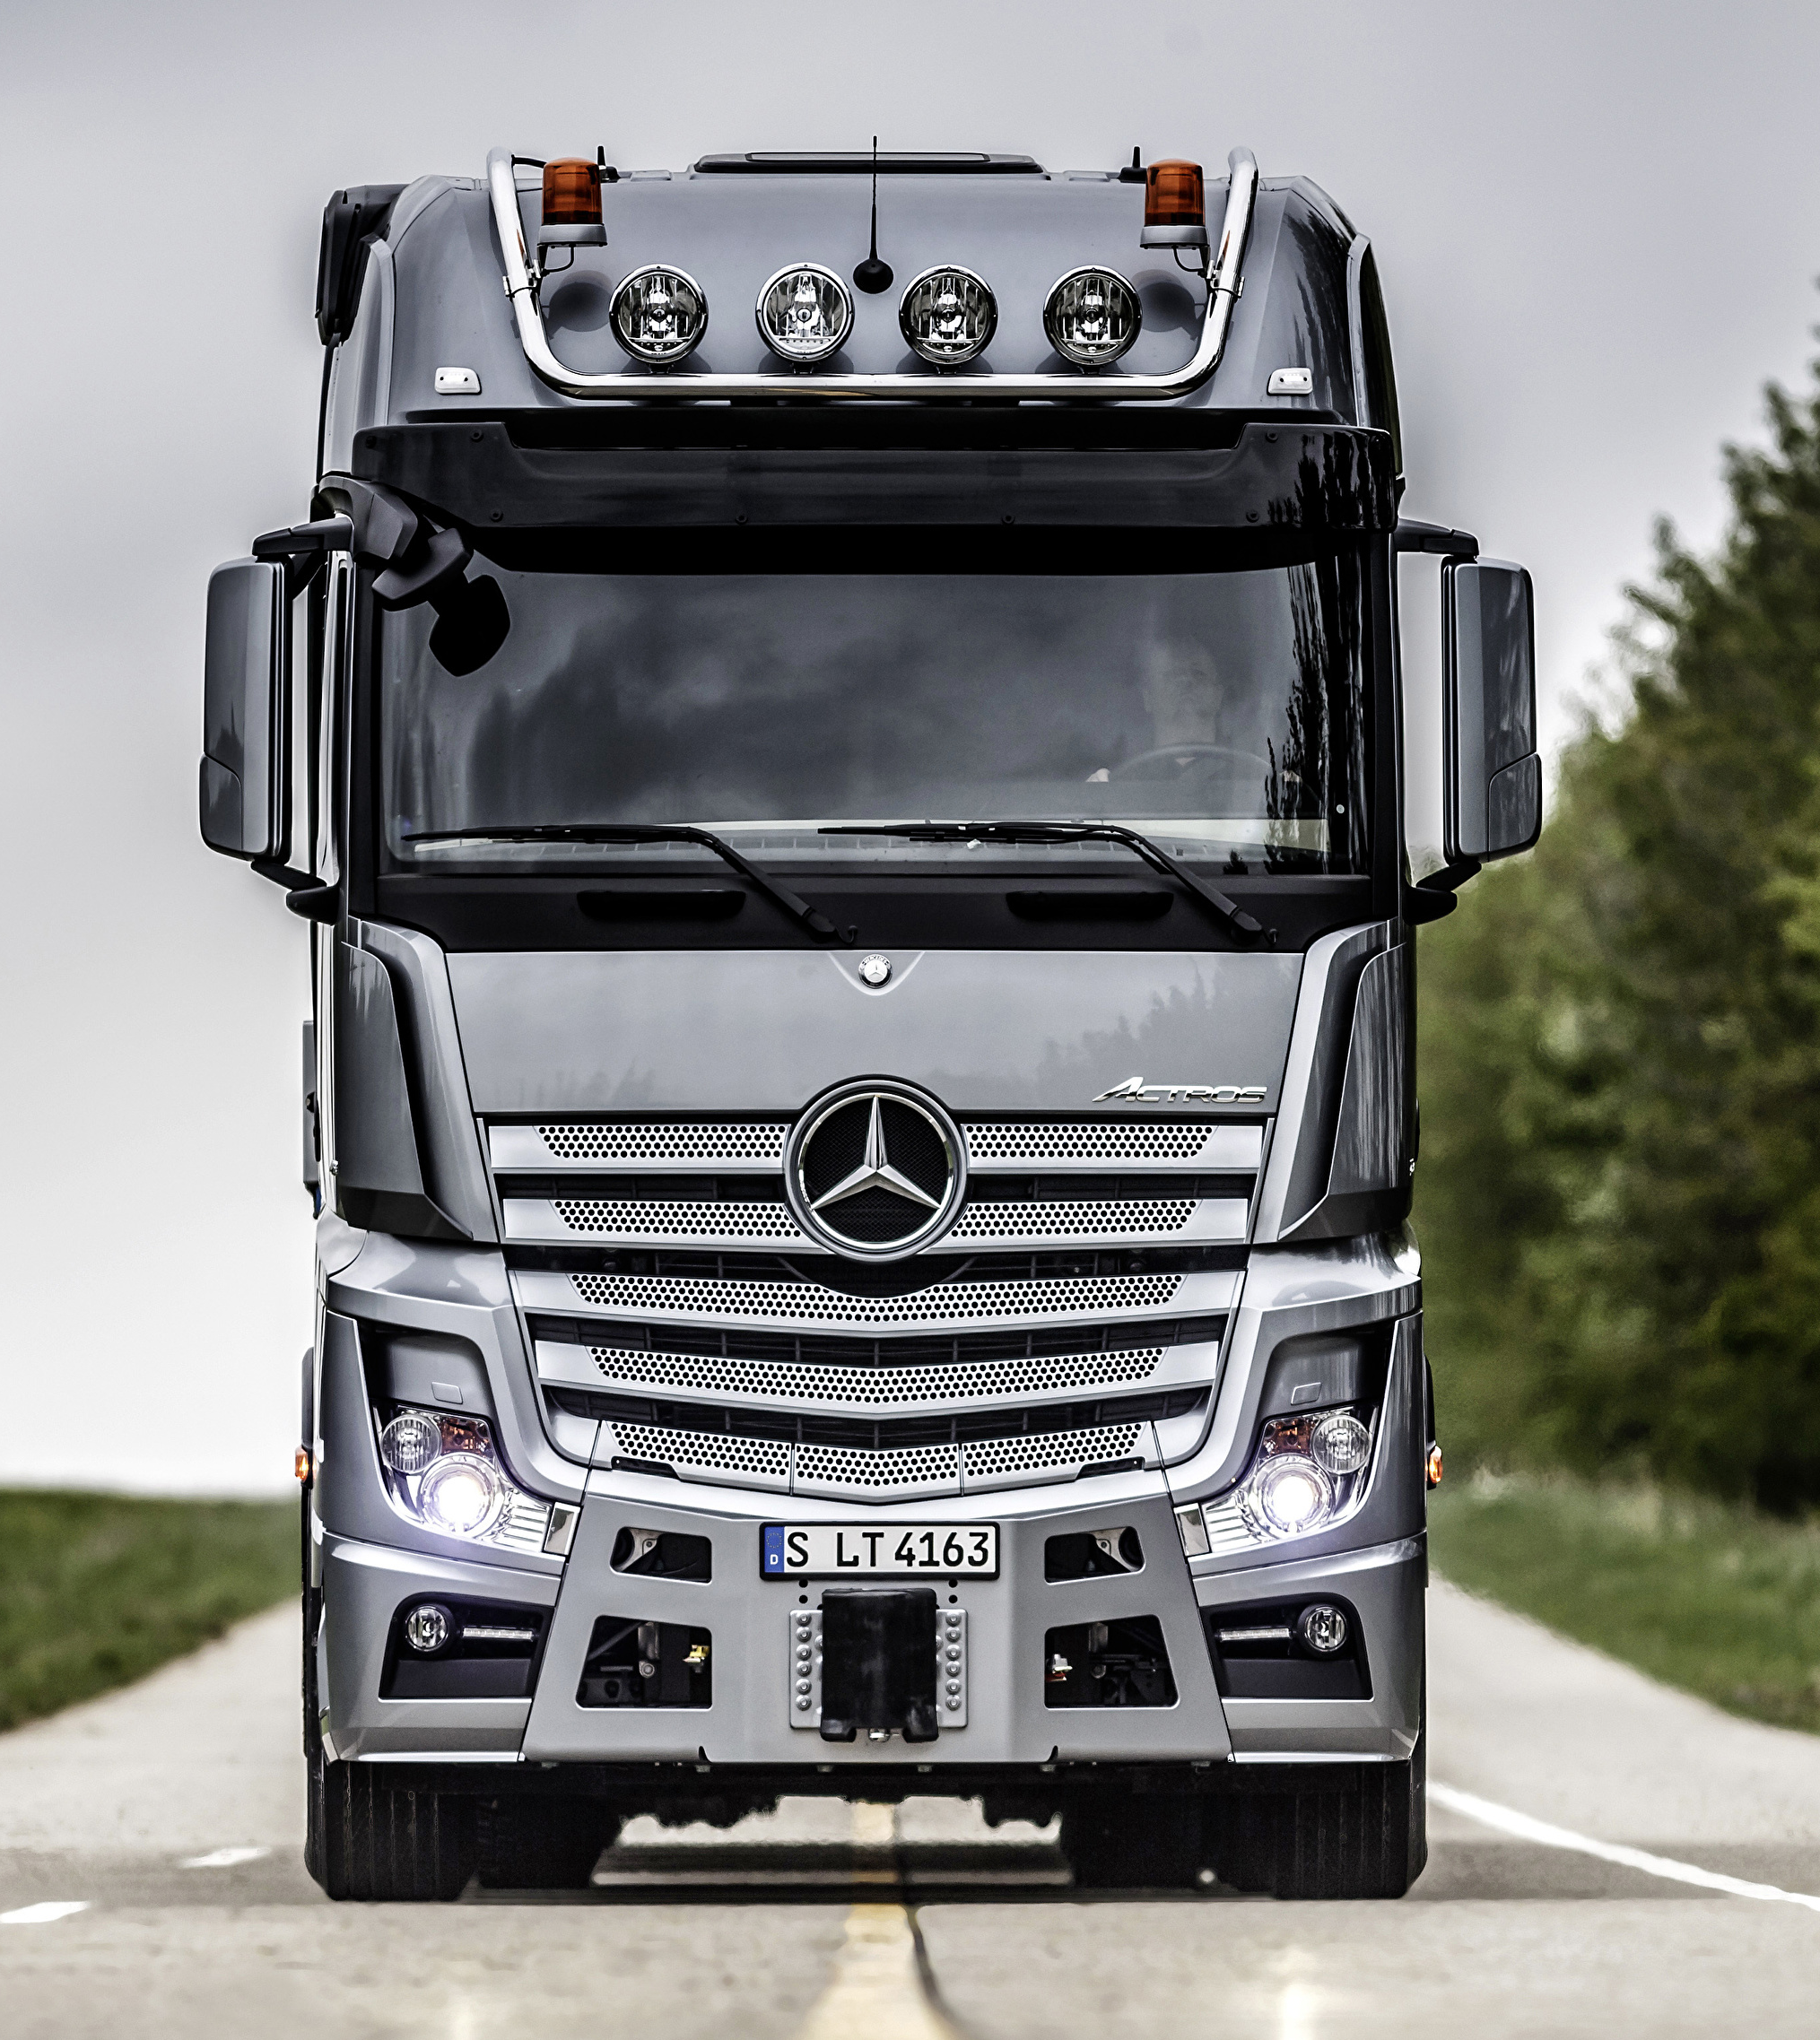




INTRODUCTION
Notes:
Hệ thống LDW đầu tiên được phát triển đầu tiên bởi Mercedes-Benz trên xe tải Actros ở châu Âu. Cảnh báo bằng cách phát ra âm thanh khi tài xế chuyển làn mà ko bật xi nhan.
Nissan, TOYOTA phát tín hiệu và rà nhẹ phanh để xe về đúng làn.
Citroen, thì làm run ghế của tài xế.
-> Giảm 85% tai nạn do tài xế ngủ gật.

Slide 5
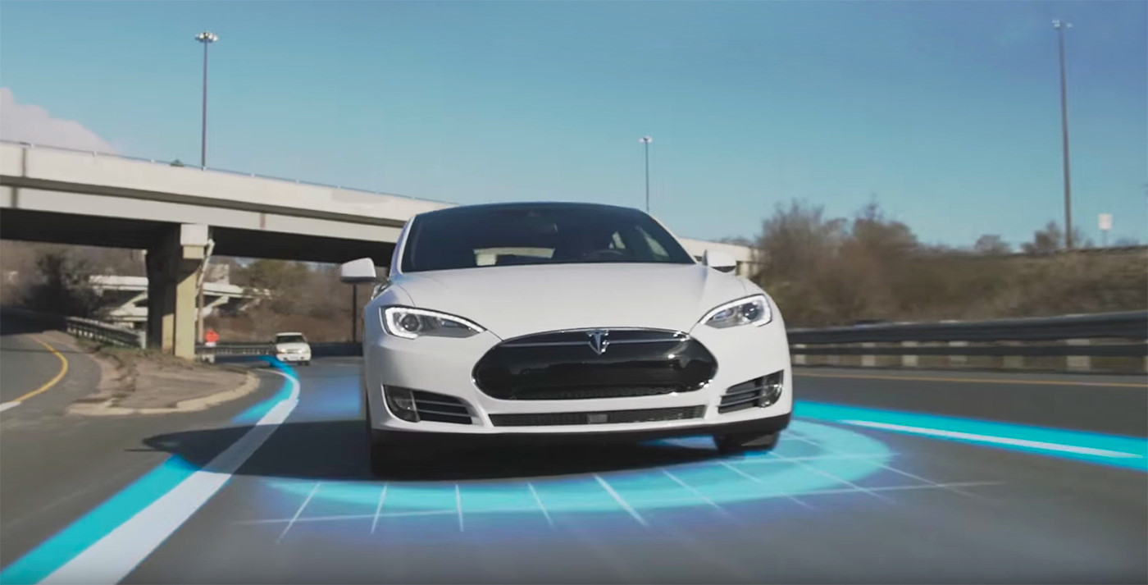
INTRODUCTION

Slide 6
THEORETICAL BACKGROUND
The following techniques are used:
Gamma Correction
Color Selection
Denoise
Region of Interest Selection (ROI Selection)
Canny Edge Detection
Hough Transform Line Detection

Slide 7
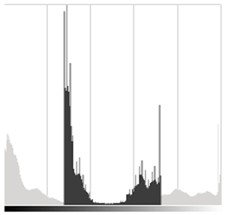
THEORETICAL BACKGROUND
Gamma correction
Histogram of image

Slide 8
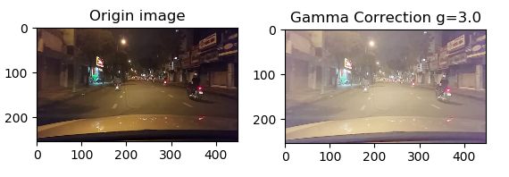
THEORETICAL BACKGROUND
Gamma correction

Slide 9
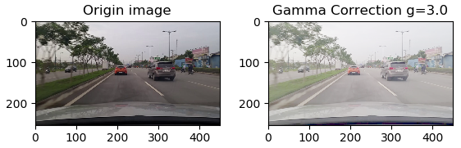
THEORETICAL BACKGROUND
Gamma correction

Slide 10
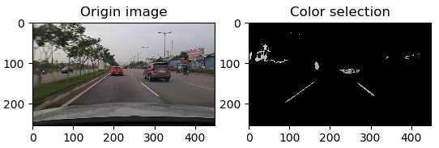
THEORETICAL BACKGROUND
Color selection

Slide 11
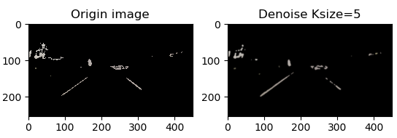
THEORETICAL BACKGROUND
Denoise

Slide 12
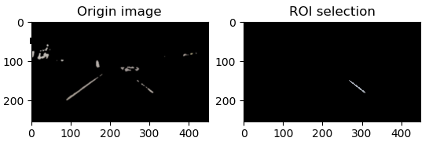
THEORETICAL BACKGROUND
ROI Selection

Slide 13
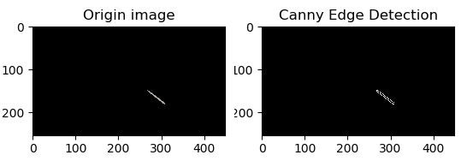
THEORETICAL BACKGROUND
Canny edge detection

Slide 14
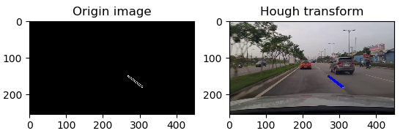
THEORETICAL BACKGROUND
Hough transform

Slide 15
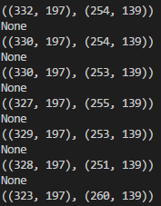
THEORETICAL BACKGROUND
Hough transform

Slide 16
LDW SYSTEM
The following techniques are used:
Warn the driver if the vehicle is leaving its lane ( LED warning)
Improve the FPS (Frame Per Second) processing rate of frames

Slide 17
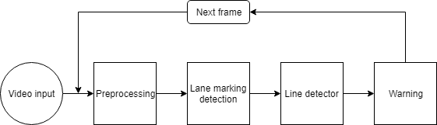
LDW SYSTEM
Model outline:

Slide 18
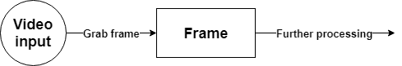
LDW SYSTEM
Reading frames from the video:

Slide 19
LDW SYSTEM
Reading frames from the video:
→ To improve the FPS processing rate of frames read from video files we are going to utilize threading and the queue data structure

Slide 20
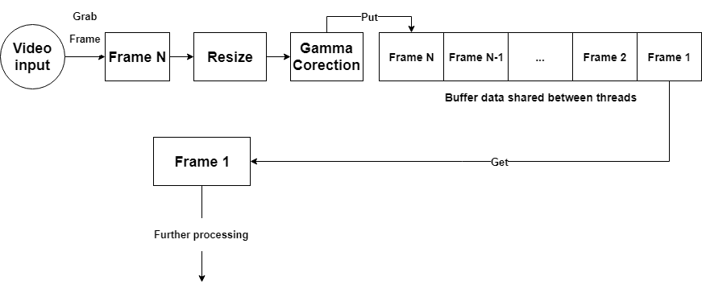
LDW SYSTEM
Reading frames from the video:
Thread 1
Thread
2
Notes:
Python 2 chia 2 số, tự động làm tròn

Slide 21
LDW SYSTEM
Reading frames from the video:
 | Normal (FPS) | Using thread and queue (FPS)
Laptop | ~ 40 - 50 | ~ 60 - 65
Raspberry pi | ~ 2 - 4 | ~ 13 - 14
Notes:
Python 2 chia 2 số, tự động làm tròn

Slide 22
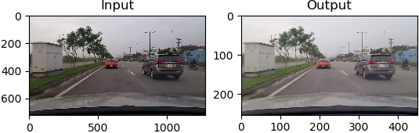
LDW SYSTEM
Reading frames from the video:
Notes:
Python 2 chia 2 số, tự động làm tròn

Slide 23
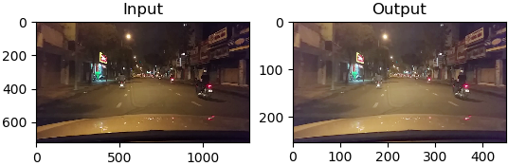
LDW SYSTEM
Reading frames from the video:
Notes:
Python 2 chia 2 số, tự động làm tròn

Slide 24
LDW SYSTEM
Preprocessing
Denoise
Gaussian (5x5)
Frame
Convert to grayscale image
ROI

Slide 25
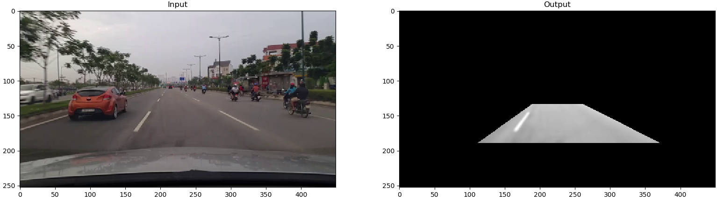
LDW SYSTEM
Preprocessing

Slide 26
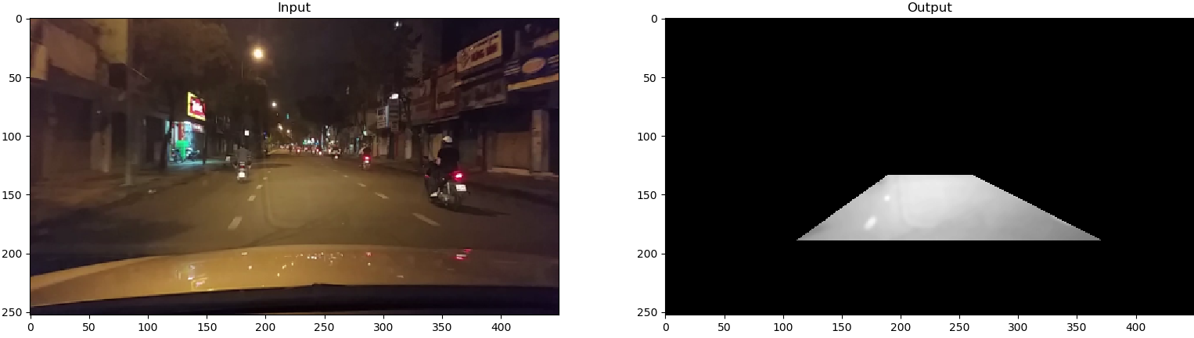
LDW SYSTEM
Preprocessing

Slide 27
LDW SYSTEM
Lane marking detection
Color thresholding
160 - 200
Preprocessing
Canny edge detection
20 - 40

Slide 28
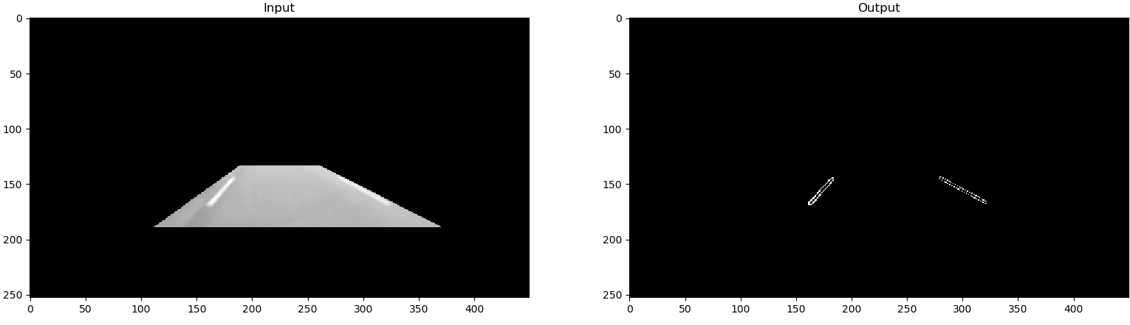
LDW SYSTEM
Lane marking detection

Slide 29

LDW SYSTEM
Lane marking detection

Slide 30
LDW SYSTEM
Line detector
Hough transform
Lane marking detection
Averaging and Extrapolating Lines
20^{O} < Angle < 160^{O}

Slide 31
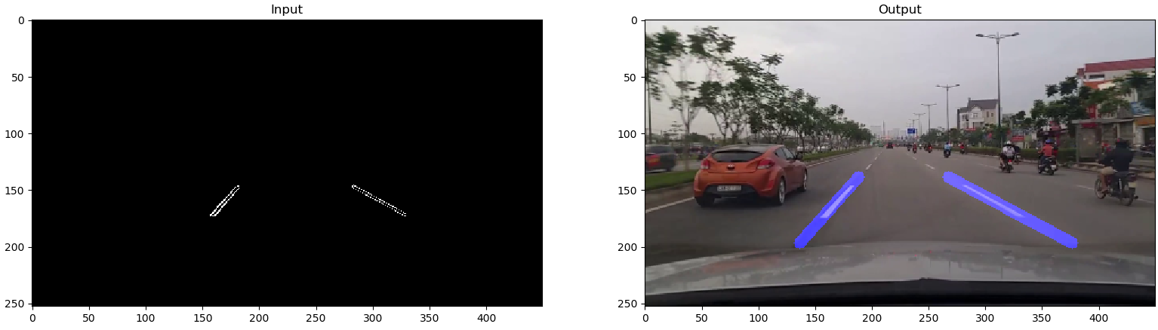
LDW SYSTEM
Line detector

Slide 32
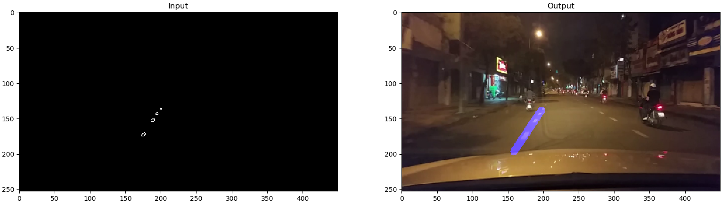
LDW SYSTEM
Line detector

Slide 33
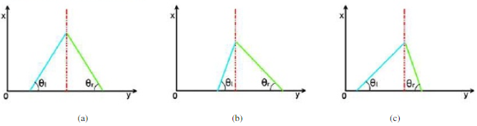
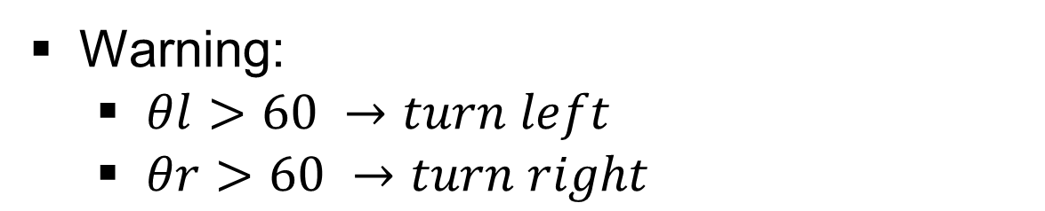
LDW SYSTEM
Warning:
$θl>60 →turn left$
$θr>60 →turn right$

Slide 34
DEMO

Slide 35
CONCLUSION
Achieved
A complete lane departure warning system with Raspberry Pi in various lighting conditions.
Increasing hPi.
Not yes?
The system hasn’t been tested on real vehicle systems and various environment conditions such as rain, faded, missing lane marking,...

Slide 36
CONCLUSION
What could be improve in the future
LDWs can integrate with the vehicle.
Testing systems on various environment conditions.
Increasing accuracy of Lane detection algorithms.

Slide 37

Q & A

Slide 38
THE END
THANKS FOR LISTENING!

Slide 39
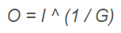
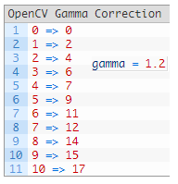
THEORETICAL BACKGROUND
Gamma correction
Look-up table

Slide 40
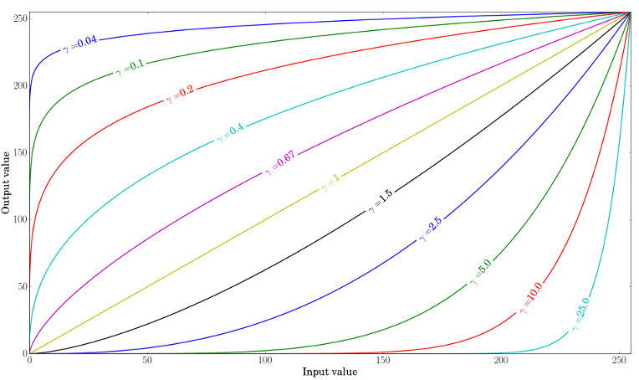
THEORETICAL BACKGROUND
Gamma correction

Slide 41
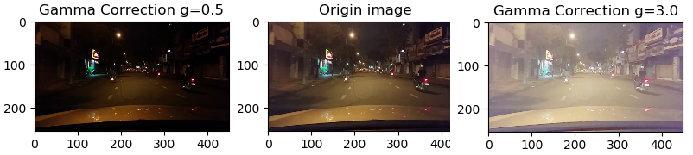
THEORETICAL BACKGROUND
Gamma correction

Slide 42
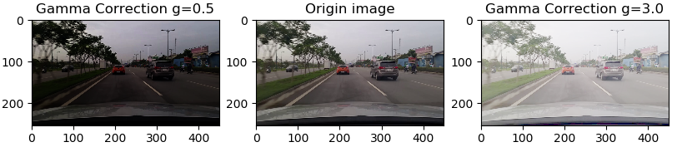
THEORETICAL BACKGROUND
Gamma correction

Slide 43
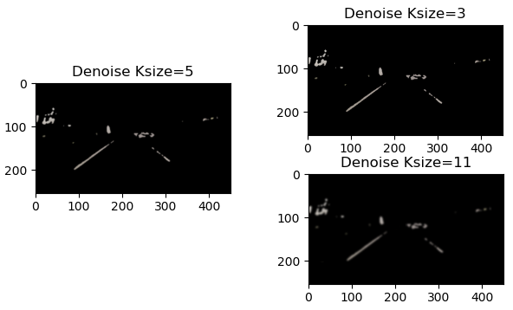
THEORETICAL BACKGROUND
Denoise

Slide 44
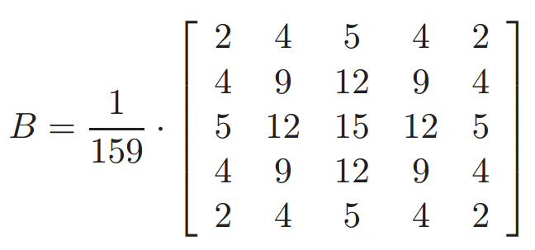
THEORETICAL BACKGROUND
Denoise
Gaussian filter

Slide 45
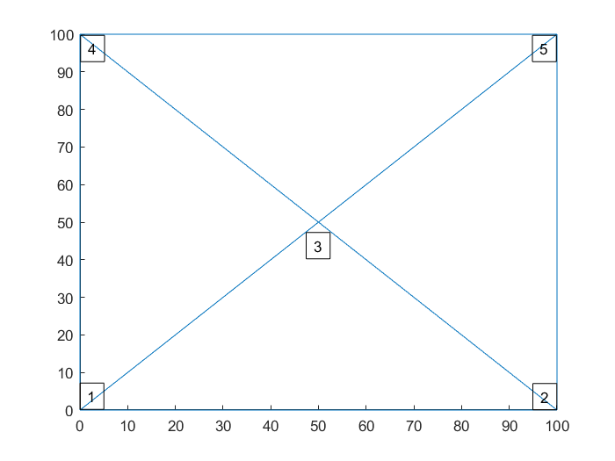
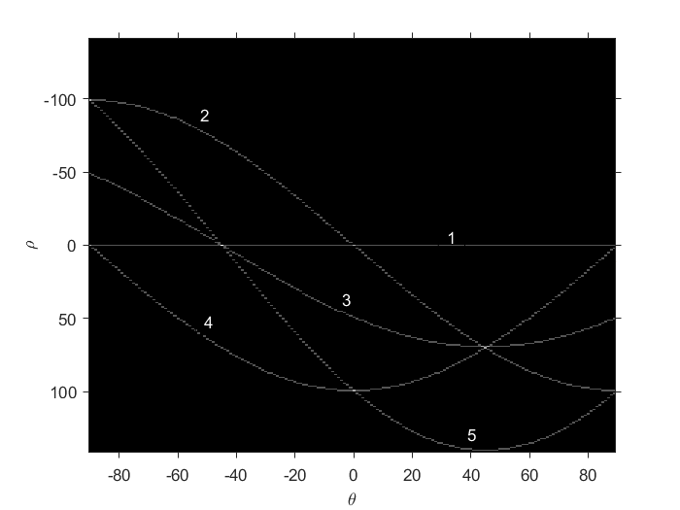
THEORETICAL BACKGROUND
Hough transform
transform
Five point in Cartesian coordinate system
Their sinusoid in Polar coordinate system

Slide 46
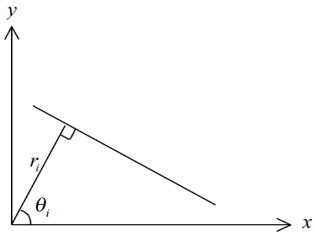
THEORETICAL BACKGROUND
Hough transform
The representation of a line in the (x, y) space using (ri, θi )

Slide 47
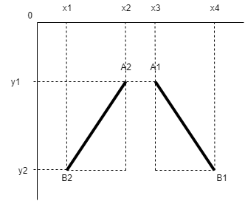
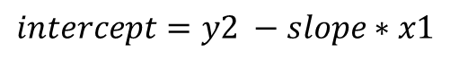

THEORETICAL BACKGROUND
Line Detector
$$slope= \frac{y1−y2}{x2−x1}$$
$$intercept=y2 −slope∗x1$$
If slope < 0 : return left
Else return right

Slide 48
THEORETICAL BACKGROUND
Raspberry pi
Broadcom BCM2837 chipset running at 1.2 GHz
64-bit quad-core ARM Cortex-A53

Slide 49
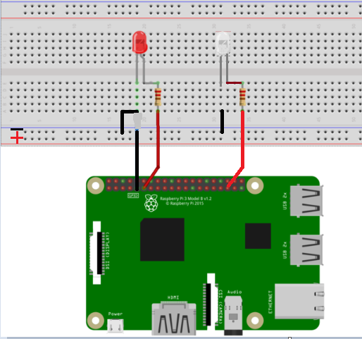
LDW SYSTEM
Control LEDs with Raspberry Pi 3

